Slide 1









Whiteboardmaths.com
7
2
1
5
© 2004 All rights reserved

Slide 2
Frequency Tables
It is often convenient to record data in a frequency table. This is particularly useful when there is a large amount of data. The mean, mode, median and range can be calculated directly from the table.
Here is some data on
class sizes in a school.
Class Size | f
27 | 2
28 | 4
29 | 3
30 | 5
31 | 2
32 | 1
27, 27, 28, 28, 28, 28, 29, 29,
29, 30, 30, 30, 30, 30, 31, 31, 32
Data placed in a frequency table

Slide 3


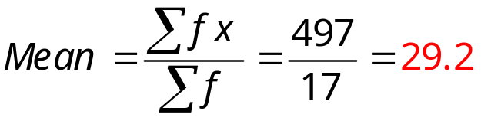
Frequency Tables
Calculating the mean from the frequency table.
Class Size x | 27 | 28 | 29 | 30 | 31 | 32
f | 2 | 4 | 3 | 5 | 2 | 1
fx
54
112
87
150
62
32
Or if entered directly into a calculator.
(2 x 27 + 4 x 28 + 3 x 29 + 5 x 30 + 2 x 31 + 1 x 32)
17
= 497/17 = 29.2
Mean =
Original data in list form:
27, 27, 28, 28, 28, 28, 29, 29, 29, 30, 30, 30, 30, 30, 31, 31, 32

Slide 4
Frequency Tables
Finding the mode, median and range from the frequency table.
Class Size | 27 | 28 | 29 | 30 | 31 | 32
f | 2 | 4 | 3 | 5 | 2 | 1
Mode = 30 (Highest frequency)
Median = 29 (The middle data value) [(17 + 1)/2 = 9th data value.]
Range = 32 – 27 = 5
Original data in list form:
27, 27, 28, 28, 28, 28, 29, 29, 29, 30, 30, 30, 30, 30, 31, 31, 32

